Slide 1

Song Recommendation Algorithm
In this presentation, we'll walk you through our approach, detailing the key components, features, and implementation plan of song recommendation algorithm.
Group:
Aditya Dwihutama SUMARYANTO
Andre
Romaisa
Suranjana

Slide 2
Problem
1. Retrieve lost user playlist data
2. Generate a song recommendation algorithm and suggest several song features as an algorithm input

Slide 3
Pipeline Overview
Data Overview: Looking on features
Features Selection and scaling
Model Training and Prediction: Selecting Model / Approaches
Evaluation

Slide 4
Dataset Overview
Dataset have 22 columns which we will group to 3 categories
Song Metadata (6)
Song Technical Features (14)
Name
Album
Artist
Release_date
Uri
Release_year
Length
Acousticness
Danceability
Energy
Instrumentalness
Liveness
Loudness
Speechiness
Tempo
Valence
Time_signature
Key
Mode
Popularity (0-100, track popularity based on number of play and recent play)
Numerical values with different scale
Users Data (2)
Top_year (user’s top tracks year)
user

Slide 5
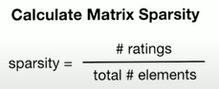
Dataset Overview
Create User-Item Matrix and Check Sparsity, we get the sparsity is 20% in this dataset
Users | Song | Popularity
Alpha | 1 | 80
Beta | 2 | 50
Gamma | 3 | 50
 | Song 1 | Song 2 | Song 3
Alpha | 80
Beta |  | 50
Gamma | 50

Slide 6
Features Selection and scaling
Since we have 14 audio features, we will do feature selection to get most relevant audio features with popularity as the target label
The workflow as follow:
Create pipeline consist of scaling (MinMaxScaler) and feature selection (SelectKBest) with score function regression since we wanted features that positively correlated with popularity
Add Hyperparameter tuning for parameter K in SelectKBest using Grid Search with cross validation and apply Negative MSE as scoring metric since the feature selection is regression
Apply the best parameter and check the selected features

Slide 7
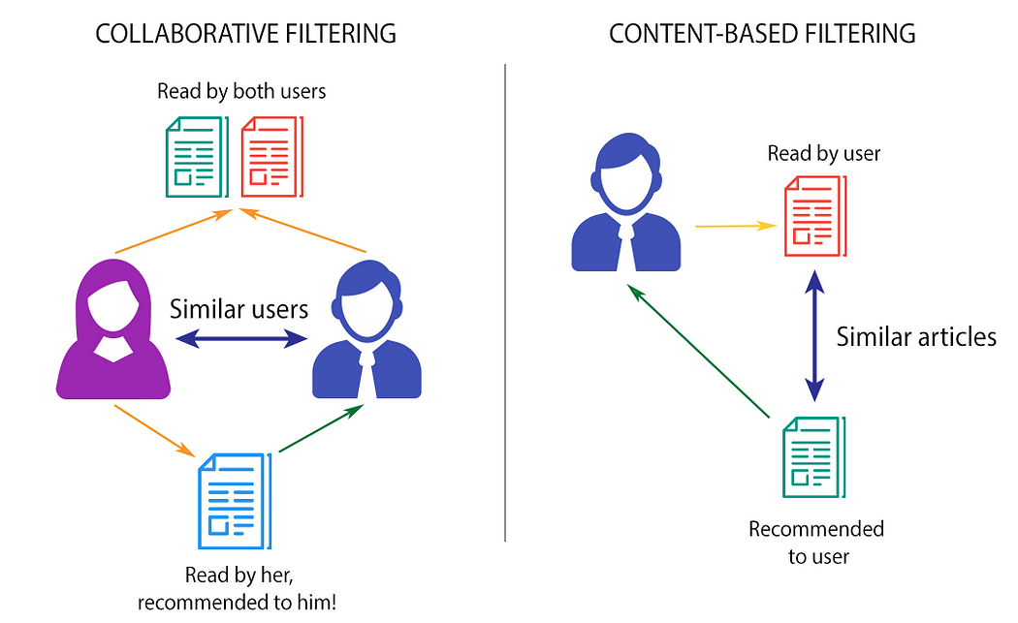
Model Training: Model Selection
After we have selected best features, we need to choose the algorithm of our recommender system. We will use the hybrid of Collaborative filtering and content-based filtering to taking account of User-Item interaction(CF) and Item-Item Similarity (CBF). To give recommendation for specific users and also with similar songs

Slide 8
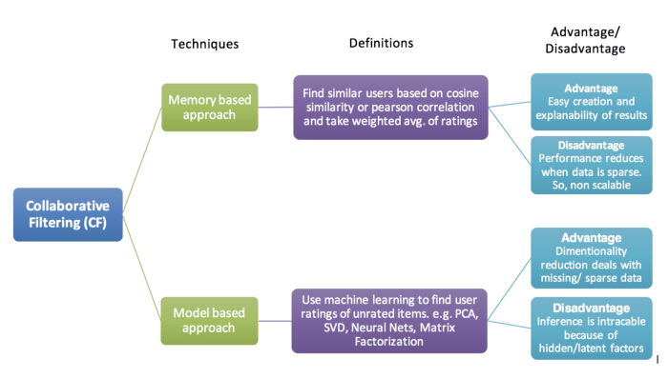
Model Training: Model Selection
For the collaborative filtering, looking at our dataset, since we have smaller dataset (one family account) and high sparsity (20%) therefore we will use model-based approach specifically Alternating Least Square (ALS) algorithm because it can handle sparse dataset

Slide 9
Model Training: Collaborative Filtering
We will use User-Item interaction matrix which in our data is:
user, popularity and top_year
Create a matrix of users and songs with the value is interaction score
 | Song 1 | Song 2 | Song 3
Alpha | 0.8
Beta |  | 0.5
Gamma | 0.5
Alternating Least Square
 | Song 1 | Song 2 | Song 3
Alpha | 0.8 | 0.6 | 0.5
Beta | 0.7 | 0.5 | 0.4
Gamma | 0.5 | 0.7 | 0.8
Parameter:
Factor
Regularization
Predicted value
Interaction Score = scaled popularity x scaled top_year
2
Popularity (assuming higher popularity is more favourable by users)
And top_year which will be scaled from 0 to 1 as factor to popularity (more recent year give higher score)

Slide 10
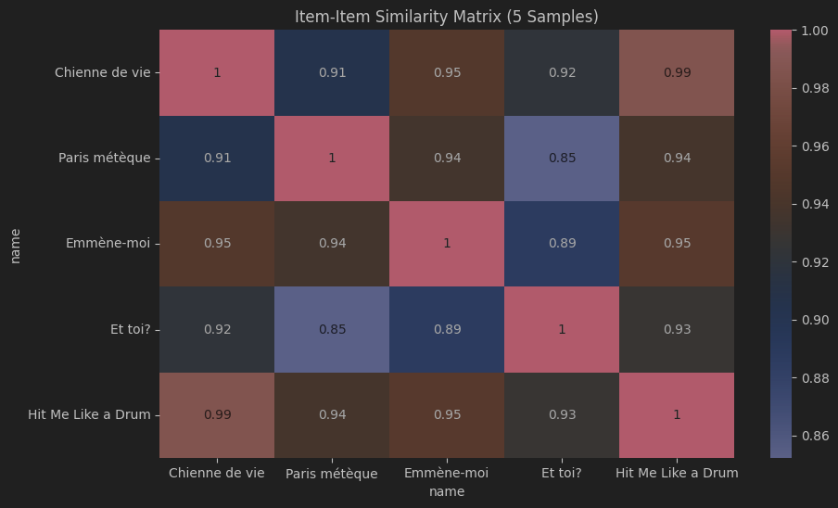
Model Training: Content Based Filtering
Create item-item similarity matrix using song technical features from feature selection results applying cosine similarity
sklearn.metrics.pairwise.cosine_similarity

Slide 11
Model Training: Creating Hybrid Model
Combining collaborative filtering and content-based filtering by giving a weight factor to each results
Final Recommendation = α x scaled_ALS_score + β x scaled_CBF_score
User Related
Song Related
We try to set α = 0.4 and β = 0.6 to emphasize more on song related factor since the user-item data is very sparse

Slide 12
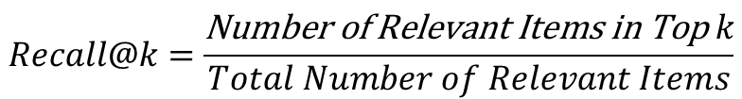
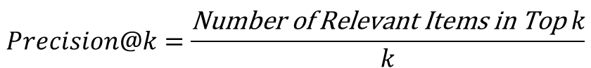
Evaluation
To evaluate the recommendation result we will use Precision@K and Recall@K where:
Precision@K is proportion of number of relevant items to K recommendation
Recall@K is proportion of relevant items in K recommendation to total relevant items
$$Precision@k=\frac{\text{Number} \text{of} \text{Relevant} \text{Items} \text{in} \text{Top} k}{k}$$
$$Recall@k=\frac{\text{Number} \text{of} \text{Relevant} \text{Items} \text{in} \text{Top} k}{Total Number of Relevant Items}$$
To determine relevant items, we will use final score threshold of 0.8 to be considered as relevant items for users

Slide 13
Appendix
How to Design and Build a Recommendation System Pipeline in Python (Jill Cates)
Recommendation Systems — A walk through
Basics of Content Based and Collaborative Based Recommendation Engines

